Slide 1
Restaurant Recommender System USF MSAN 697
Jan 19, 2018
Devesh Maheshwari, Kunal Kotian, Nimesh Sinha, Sooraj Mangalath Subrahmannian

Slide 2
Yelp Challenge Dataset
6 GB of curated data
JSON format
7 million ratings & tips of 150,000 businesses
Diverse data - scope for exploring several ML approaches
Recommender system
Sentiment analysis
Topic modeling
Network analysis

Slide 3
What We Focused On
Objective: Recommending restaurants to users
Why this interests us
Data includes
Explicit star ratings (out of 5) + full text reviews
Text-only ‘tips’
Exploring collaborative filtering + sentiment analysis using Spark

Slide 4



Data Pipeline
Initial data loading & cleaning:
Modeling:

Slide 5
EC2/EMR Specifications
Mongo DB hosted on AWS t2.medium
AWS EMR cluster for data processing and modeling
1 Master and 2 worker EC2 instances
r3.2xlarge instances
8 cores and 60 GiB Memory

Slide 6
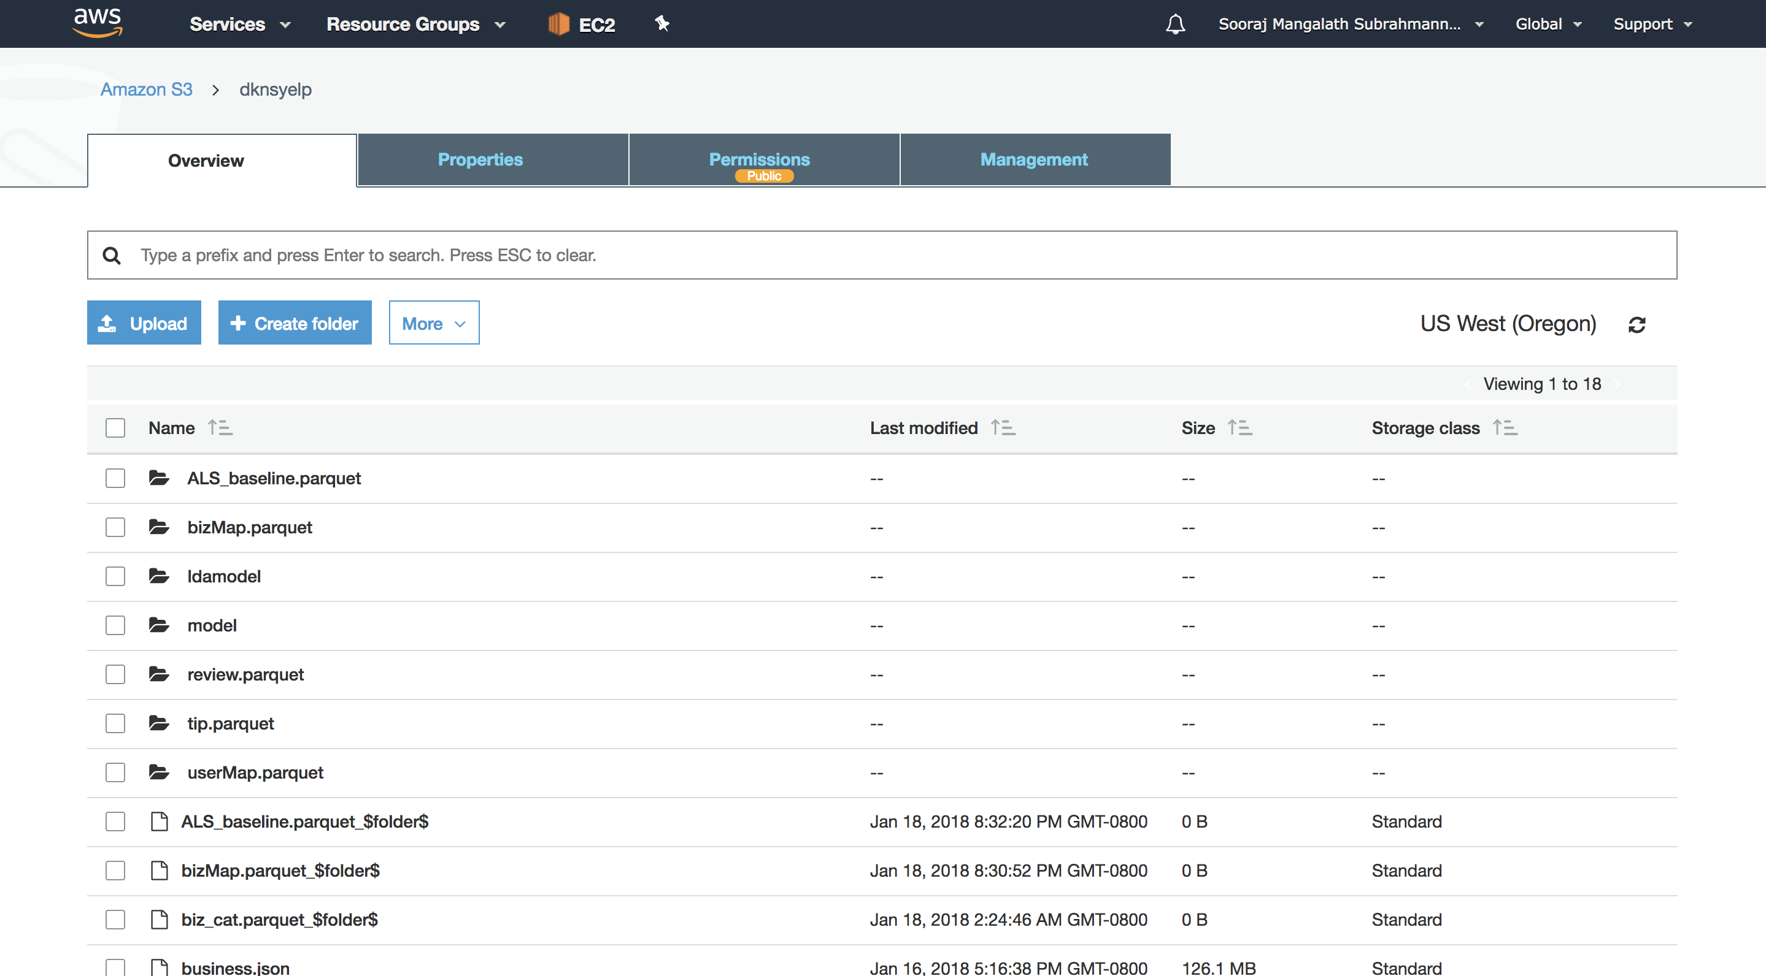
Data on Amazon S3

Slide 7
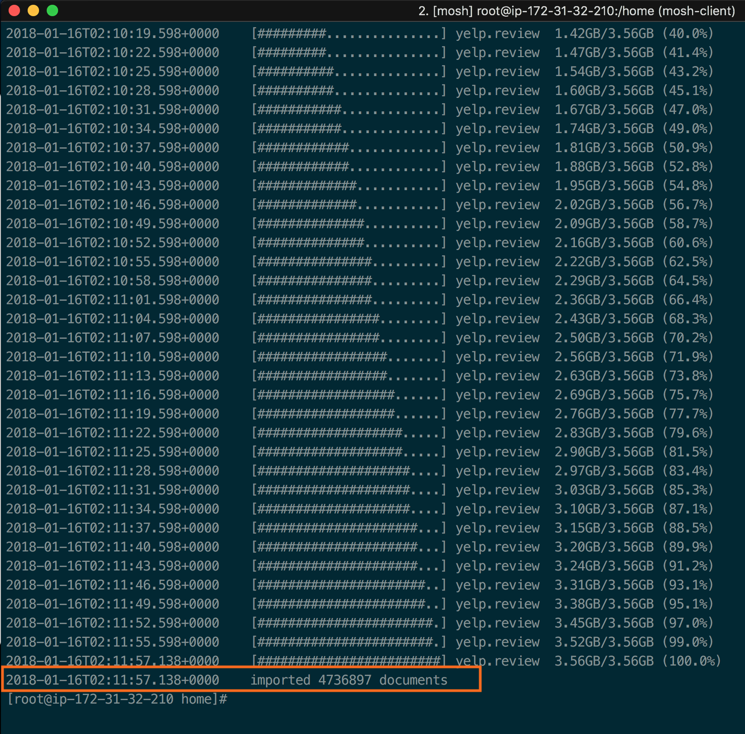
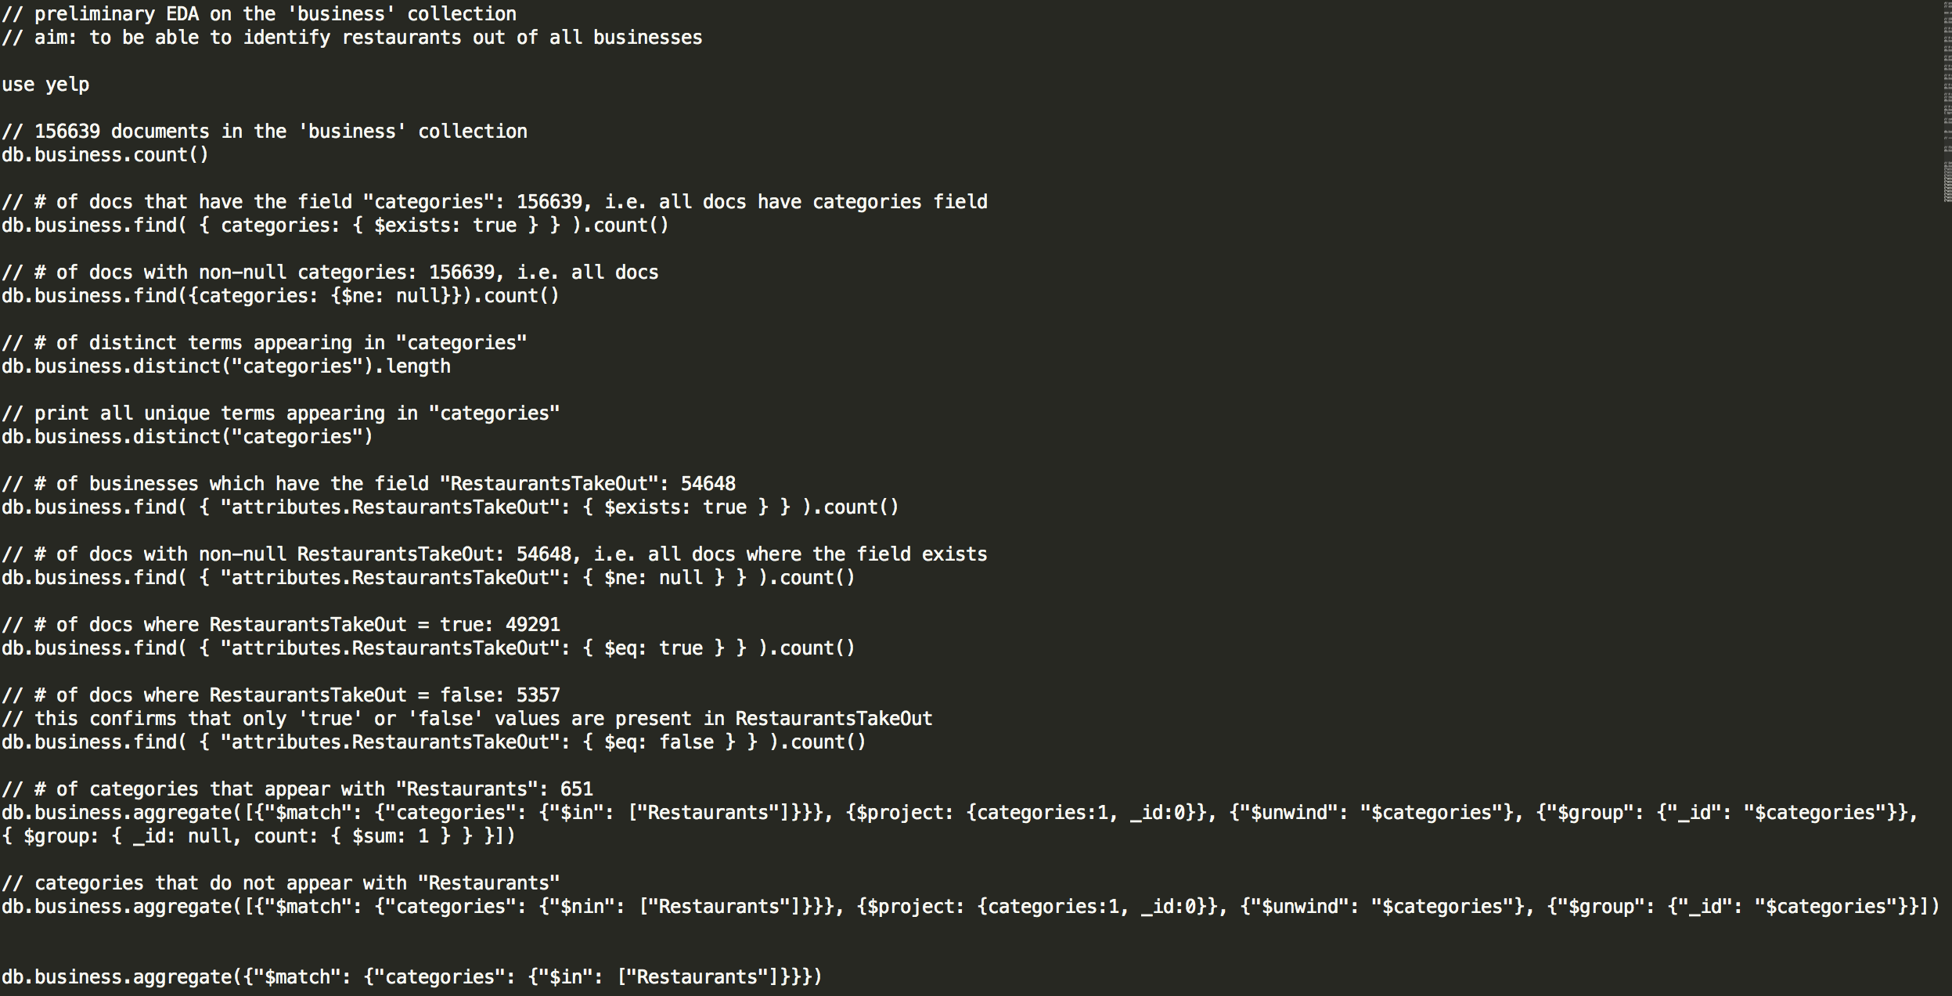
MongoDB
MongoDB queries for exploratory data analysis:
Load data into MongoDB

Slide 8
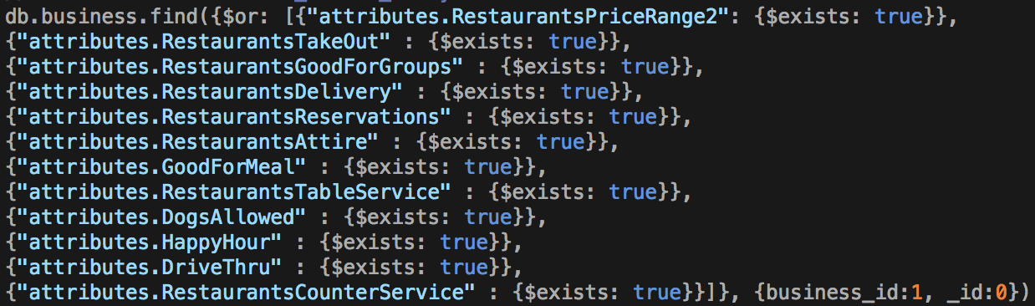
Identifying Restaurants in the Dataset
Recursively extracted all existing keys and their occurrences
https://github.com/variety/variety
+
Businesses explicitly categorized as restaurants

Slide 9
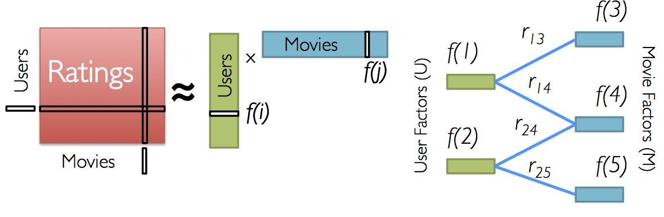
ML Step 1: Recommender System
Used explicit star ratings
Spark ML library
Collaborative filtering using Alternating Least Squares algorithm

Slide 10
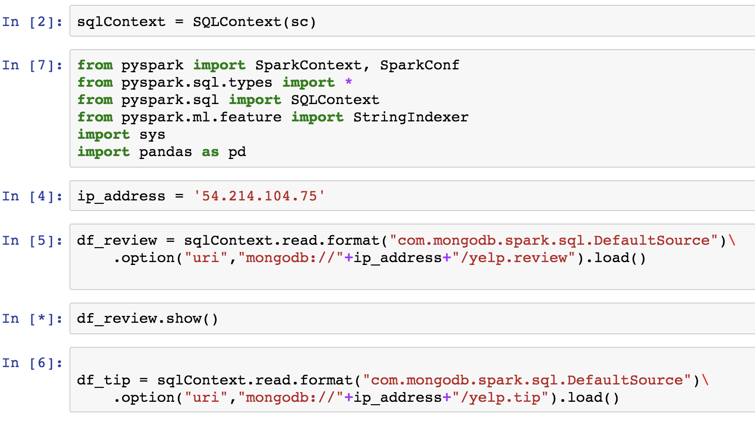
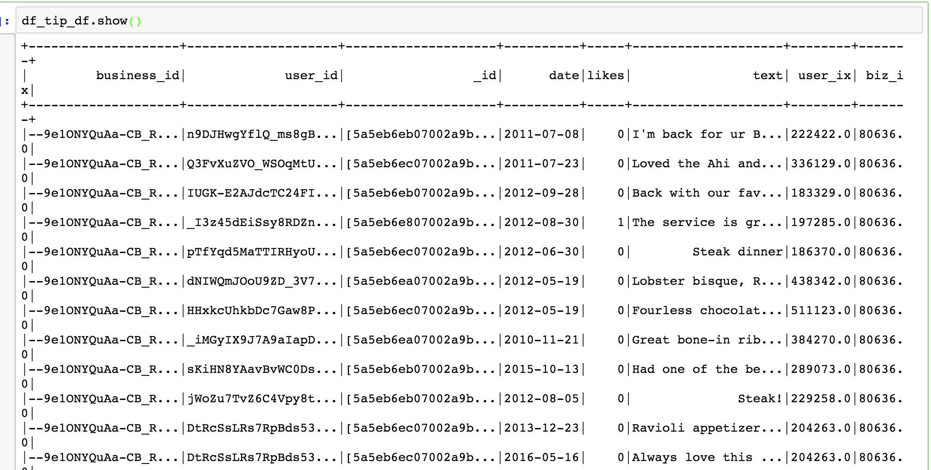
Dataframe Creation

Slide 11
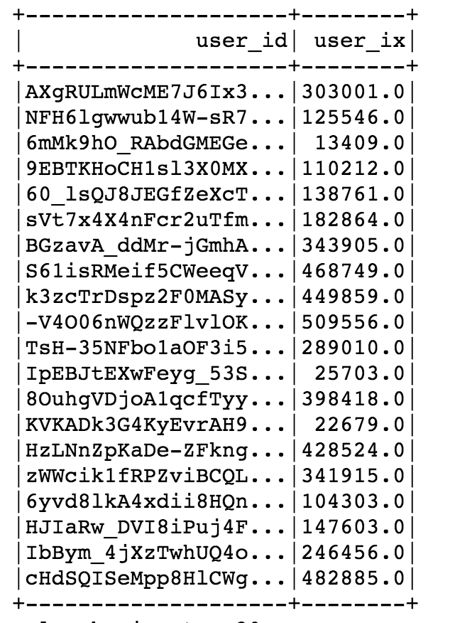
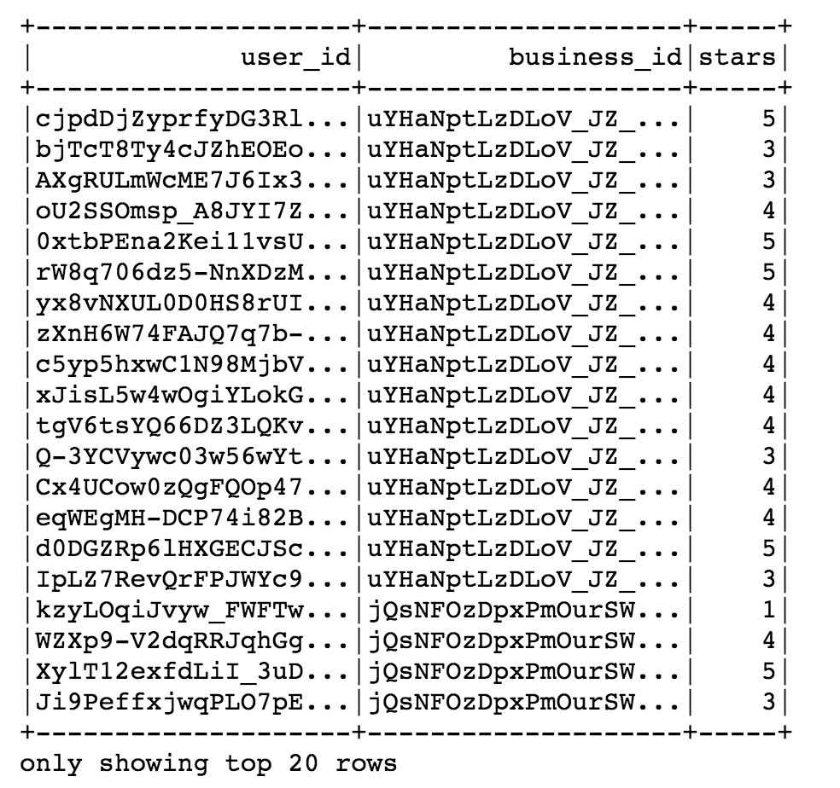
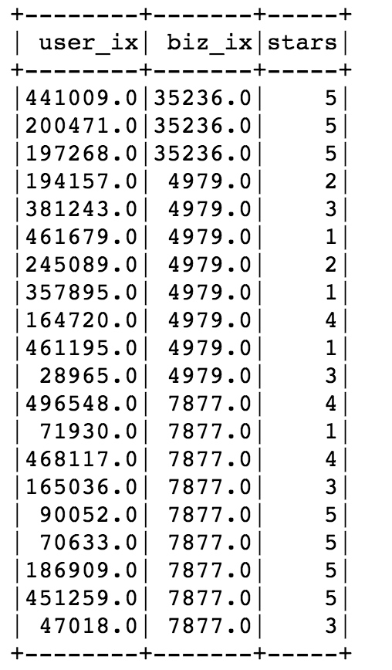
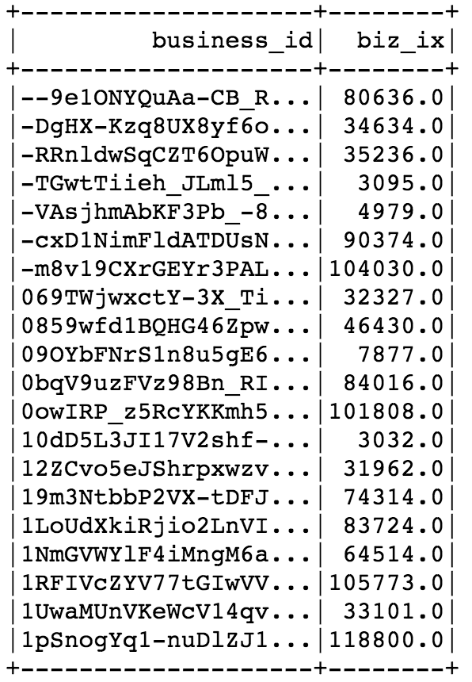
Spark SQL
Integer code for user_id
Pre-processed data for ALS
Review data set
Integer code for biz_id

Slide 12
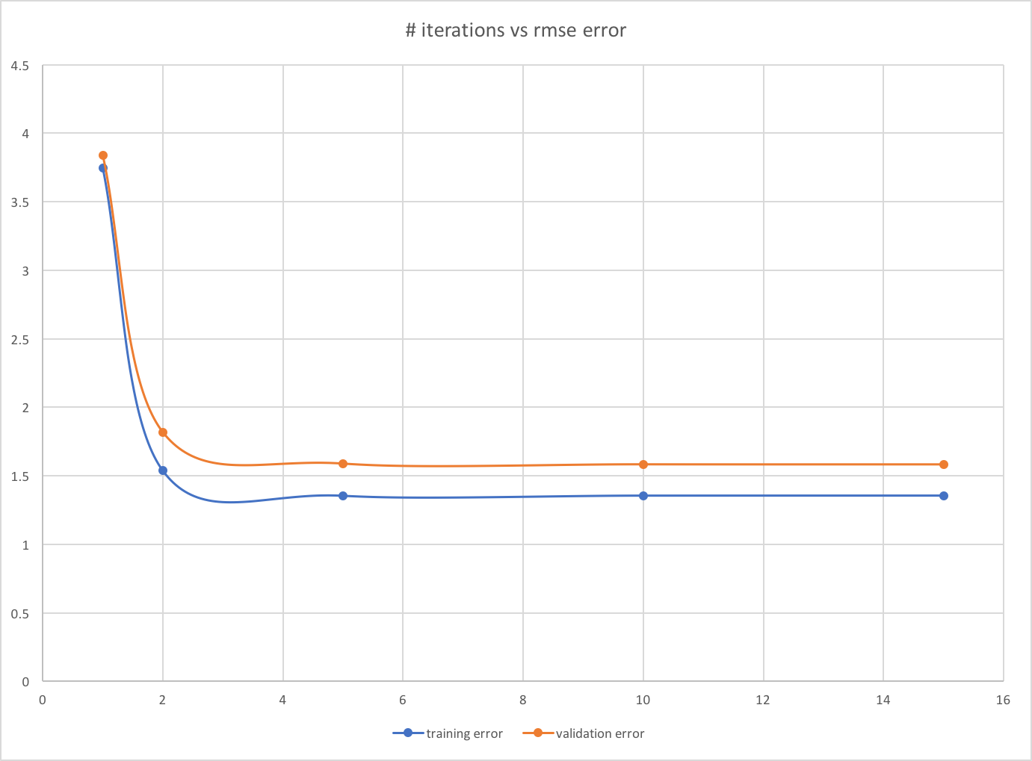
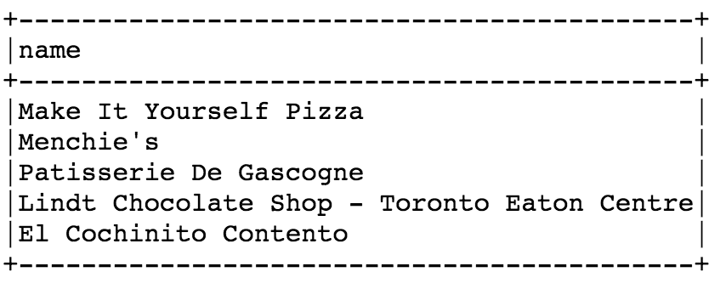
Results from ML1
The ALS algorithm was run with default setting by just varying the maxIterations.
The rank hyper parameter was further tuned using cross-validation.
The validation RMSE for this approach was 1.61.
The algorithm was used to recommend restaurants to users. For a user named ‘Sabastian’, the recommended restaurants are

Slide 13
ML Step 2: Naïve Bayes Sentiment Classifier
Trained on reviews with text as well as star ratings
Predicted star ratings of text-based ‘tips’
Expanded dataset of explicit star ratings

Slide 14
ML Step 3: Recommender System v2
Trained on expanded star ratings dataset
> 2x increase in available ratings
Validation RMSE similar to initial recommender system
But wider coverage of businesses and users

Slide 15
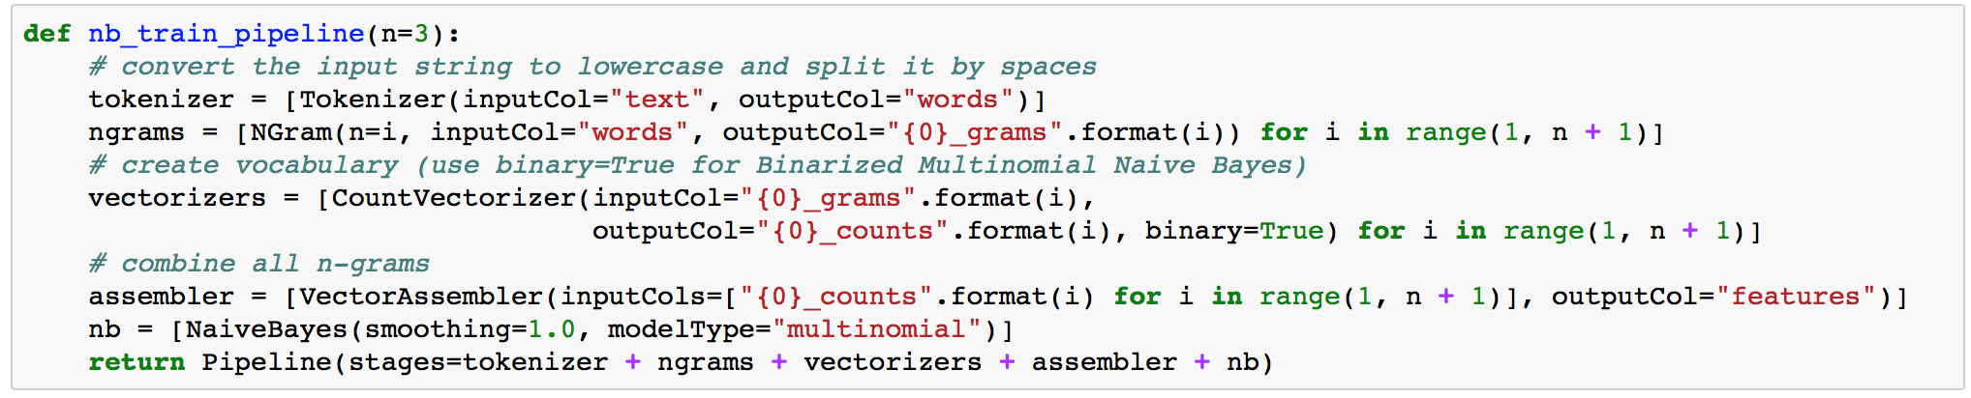
Learnings
This is awesome:
Consistency in transformation of training and test data
Concision and improved readability

